Slide 1
Project TrisPrint:
Final Testing Presentation
ME 486C
Team Members:
Shilo Bailey, Nathan Bastidas, Cassina Olson, Carter Rhoades

Slide 2
Design Requirements:
Customer Requirements
Customer Requirements | Description
Fully 3D Printable and Open Source (CR 1) | Client has requested that the device is able to be fully 3D printed with detailed instructions and clear disclaimers towards what materials and printing tolerances are required for the device.
Medically Safe For User (CR 2) | The device must be made entirely out of FDA / ISO compliant materials that, during normal operation, should not cause any short- or long-term damage to the patient.
<$50 Per Unit (CR 3) | The total cost of printing material required to print the device must be under $50.
Ability to Measure Progress (CR 4) | To aid researchers and clinicians, the device should be able to measure out muscle displacement as well as applied force to the jaw so that progress can be measured over time.
Table I: Customer Requirements for Design
Nathan: 1

Slide 3
Design Requirements:
Engineering Requirements
Engineering Requirements | Description | Units
Quick Printing Speed (ER 1) | With a current assembly print time of ~7 hours, the team wishes to reduce this time to allow for faster production. | Hrs
Durable and Flexible (ER 2) | By determining our tolerance range in terms of elastic and tensile strength, we can ensure the device can bend and move without breaking during operation. | MPa
Easily Reproducible (ER 3) | By refining the CAD model, as well as the instruction suite and print settings, the device should be able to be reproducible with limited need for modification of the model or printer being used. | N/A
Measurement System (ER 4) | The device should be able to measure out incisor displacement (in mm) and applied force to jaw (in N) | (mm), (N)
Table II: Engineering Requirements for Design
Carter: 2

Slide 4
Design Requirements:
Correlations
Customer Requirements | Correlation | Engineering Requirements
Fully 3D Printable (CR 1) | To ensure easy and quick replication, both speed and a one-print setup is key to developing an easy access Trismus device. | Quick Printing Speed (ER 1)
Medically Safe For User (CR 2) | By ensuring parts of the device won't break during operation, as well as the general safety of the material, our device will be safer than most homemade solutions. | Durable and Flexible (ER 2)
<$50 Per Unit (CR 3) | By focusing on a low cost per unit, we can ensure that this device is easily producible in mass quantities by clinics and can be afforded by a variety of patients. | Easily Reproducible (ER 3)
Ability to Measure Progress (CR 4) | With a built-in measurement system, clinicians and researchers can track a patient's progress over time and be able to note displacement and applied force. | Measurement System (ER 4)
Table III: Design Requirements Correlations
Carter: 3

Slide 5
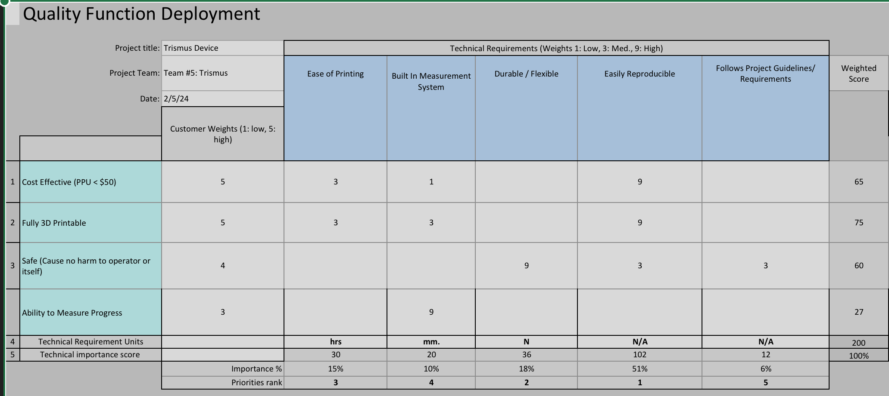
QFD
Table IV: QFD
Nathan: 4

Slide 6
Top Level Testing Summary
Engineering Requirements | ER # | Customer Requirements | CR#
Ease of Printing | ER1 | Fully 3D Printable | CR1
Durable and Flexible | ER2 | Patient Safety Priority | CR2
Easily Reproducible | ER3 | Low Cost | CR3
Built In Measurement System | ER4 | Ability to Measure Progress | CR4
Experiment / Test | Relevant DRs
Ex1: Mouthpiece Bending Stress Point | ER2 , CR2
Ex2: Spring Failure Test | ER2 , CR2, CR4
Ex3: Gear Tooth Shear Test | ER2, CR2
Ex4: Printing Calibration Tests | ER1, CR1, ER3, CR3
Ex5: Measurement Calibration Tests | ER4, CR4
Table V - Engineering and Customer Requirements
Table VI – Experiments With Associated Engineering / Customer Requirements
Cassina: 5

Slide 7
Testing Plans
Experiment #​ | Summary​ | Results​
Ex1: Mouthpiece Bending Stress Point ​ | The mouthpiece of the device will have a downward force of 60 N applied to the bridge to ensure the part fails by bending downwards. ​ | Mouthpiece Failure : 55.4 N ​
Ex2: Spring Failure Test | The springs will be stretched out until failure to ensure breaking point via elongation is less than 5 N. | Spring Failure: 7 N (avg)
Ex3: Gear Tooth Shear Test ​ | One tooth of the gear inside the device will have a downward force of 60 N applied to it to ensure the tooth shears at that force (measured in MPa).​ | Gear Tooth exceeds 60 N requirement
Ex4: Printing Calibration Tests ​ | Two different commercial, entry level FDM printers (Creality’s Ender 3 and the Bambu Lab A1) will be used for test printing to ensure little to no modification to the printer or STL files is required to print and assemble the device.​ | Minor calibrations to file needed, no printer modification necessary.​
Ex5: Measurement Calibration / Tolerance Tests ​ | Multiple rulers of the device will be printed and be compared to other standard measurements devices (rulers, calipers, etc.) to ensure the spacing on the print is accurate within that +/- 0.5 mm tolerance. The compressive springs will be attached to a test bench to ensure each compression is equal to 5 N by measuring the deflection of the spring based on a certain amount of weight. ​ | Tolerance for Ruler: +/- 0.39 mm Tolerance for Spring: +/- 0.15 N
Table VII – Testing Plans
Nathan: 6

Slide 8
Specification Sheet Preparation
Engineering Requirements ​ | Target ​ | Tolerance ​ | Measured/ ​ Calculated Value ​ | ER Met? (Y/N) ​ | Client Acceptable? (Y/N) ​
Ease of Printing ​ | 1 Print Job for entire device ​ | N/A ​ | N/A ​ | Y ​ | Y ​
Durable and Flexible ​ | Mouthpiece: Failure within 60 N ​ ​ Spring: Failure within 5 N ​ Gear Tooth: ​ Failure within 60 N ​ | Mouthpiece: +/- 5 N ​ Spring: +/- 2 N ​ Gear Tooth: +/- 5 N ​ | Mouthpiece: 55.4 N ​ ​ Spring: 7 N ​ ​ Gear Tooth: - ​ | Mouthpiece: Y​ ​ Spring: Y ​ ​ Gear Tooth: N ​ | Y
Easily Reproducible ​ | Tested between multiple FDM printers, no issues regarding functionality or tolerances ​ | Tolerancing: +/- 0.5 mm ​ Functionality: ​ Fully functional with no slippage or alignment issues ​ | N/A ​ | Y ​ | Y ​
Built In Measurement System ​ | Ensure accurate measurement for built in ruler and spring compressions. ​ | Tolerance for Ruler: ​ +/- 0.5 mm ​ Tolerance for compression: ​ +/- 0.5 N ​ | Ruler: +/- 0.39 mm ​ Spring: +/- 0.15 N ​ | Y | Y
Table VIII – Specification Sheet (Engineering Requirements)
Cassina: 7

Slide 9
Specification Sheet Preparation
Customer Requirements ​ | CR Met? (Y/N) ​ | Client Acceptable? (Y/N) ​
Fully 3D Printable ​ | Y ​ | Y ​
Patient Safety Priority ​ | Y ​ | Y ​
Low Cost ​ | Y ​ | Y ​
Ability to Measure Progress ​ | Y ​ | Y ​
Table IX - Specification Sheet (Customer Requirements)
Cassina: 8

Slide 10
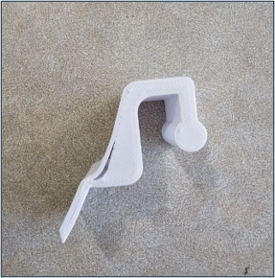
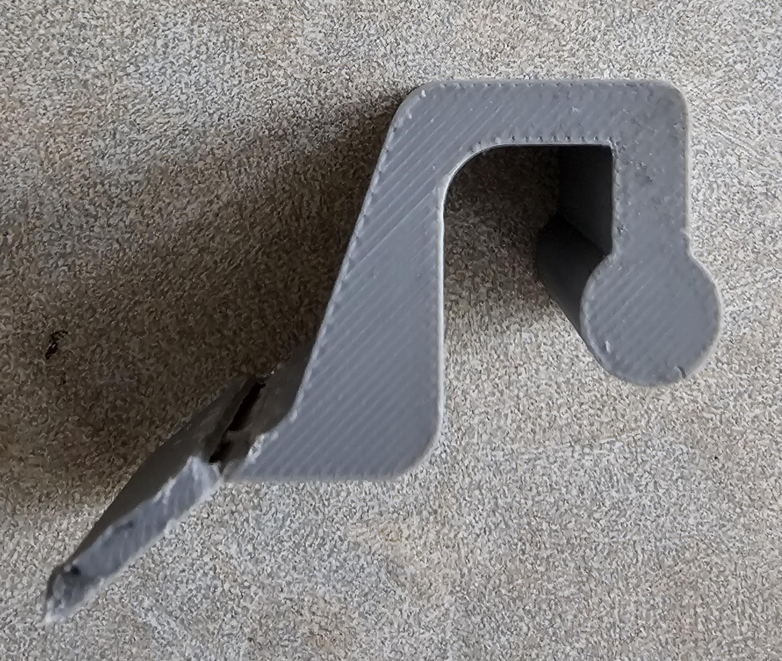
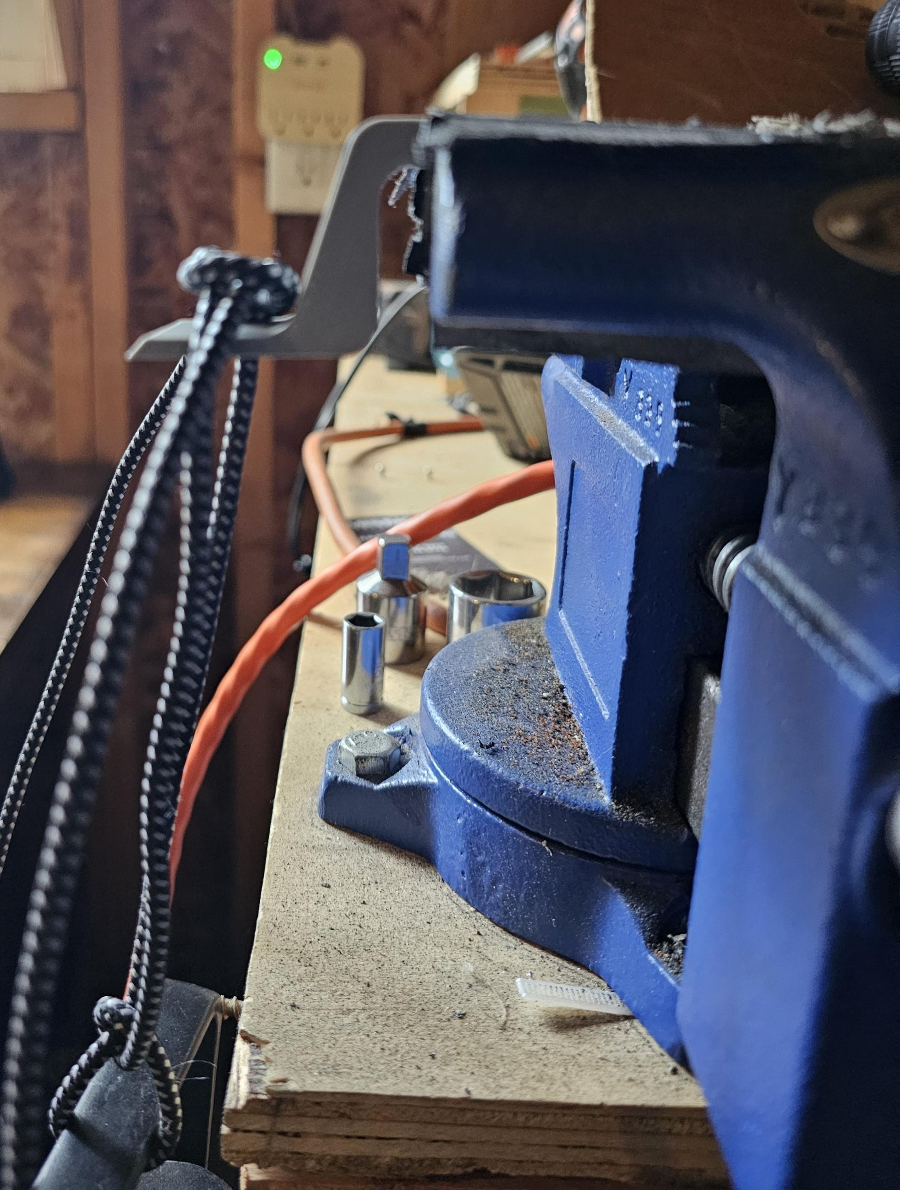
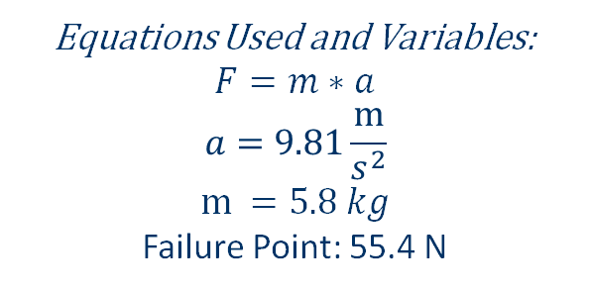
Ex.1: Mouthpiece Bending Results
Fig. I – Mouthpieces After Failure
Equations Used and Variables:
$$F=m∗a$$
$$a=9.81\frac{m}{s^{2}}$$
$$m =5.8 kg$$
Failure Point: 55.4 N
Fig. II – Mouthpieces Test
Nathan: 9

Slide 11
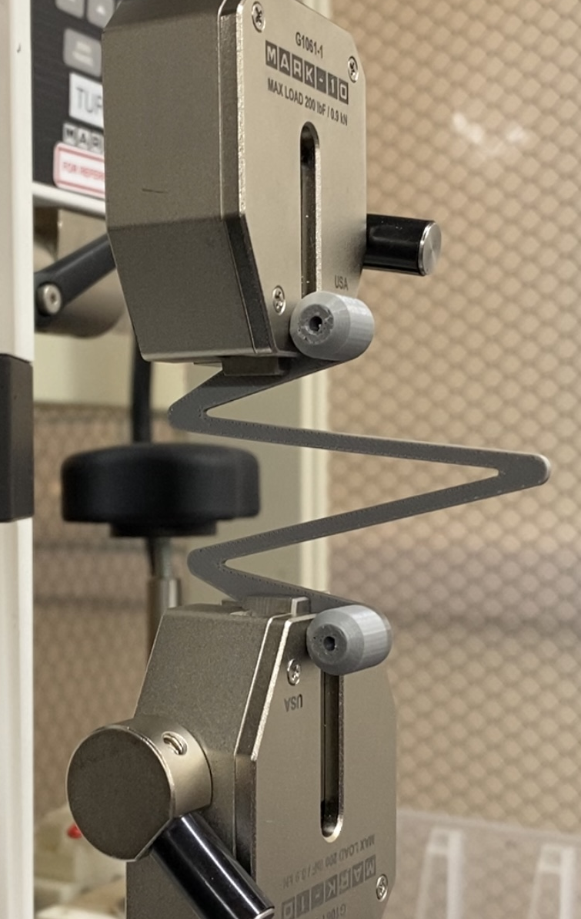
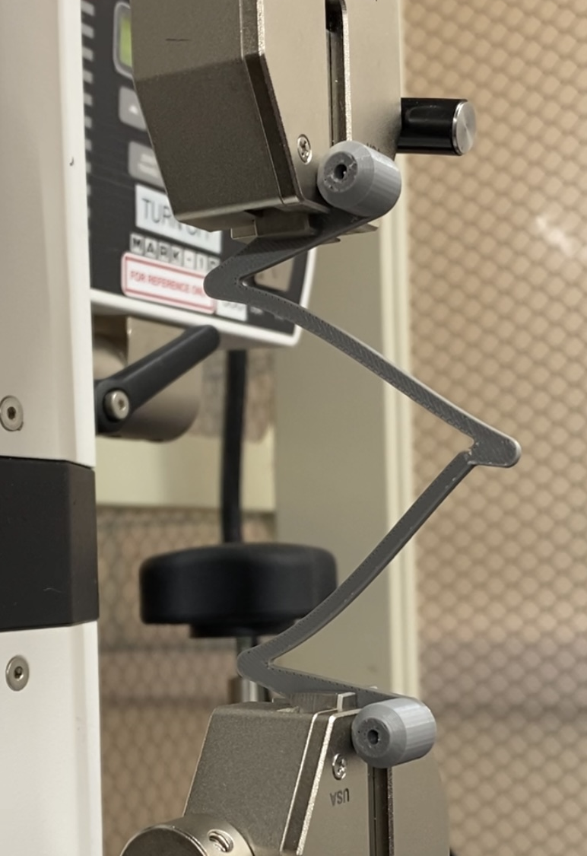
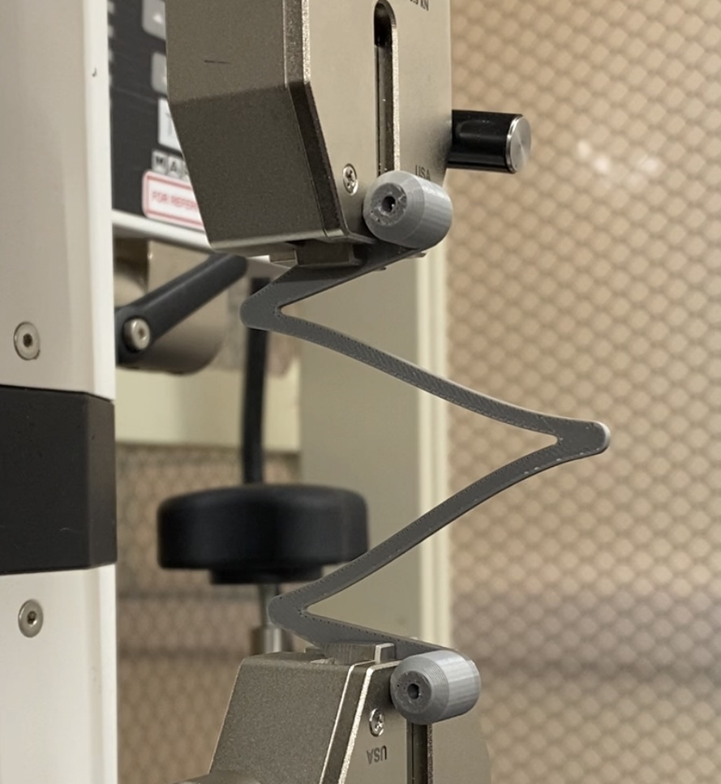
Ex.2: Spring Elongation Testing
video-20241121-000104-affdfd91.mov
Fig. III – Spring Elongation Procedure (Static to Failure)
Shilo: 10

Slide 12
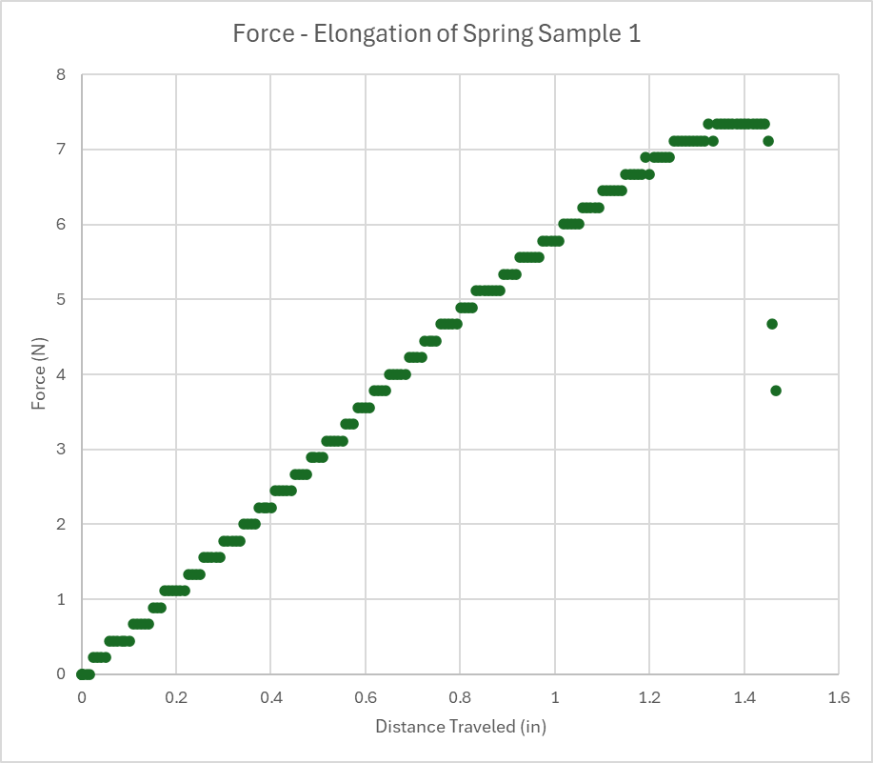
Spring Elongation Results
Spring Elongation Testing
Sample | Force (N)
1 | 7.3
2 | 6.2
3 | 7.2
4 | 7.3
5 | 7
6 | 7.2
7 | 7
Table X – Spring Elongation Failure Loads
Fig. IV – Spring Elongation Test (Sample 1)
Shilo: 11

Slide 13
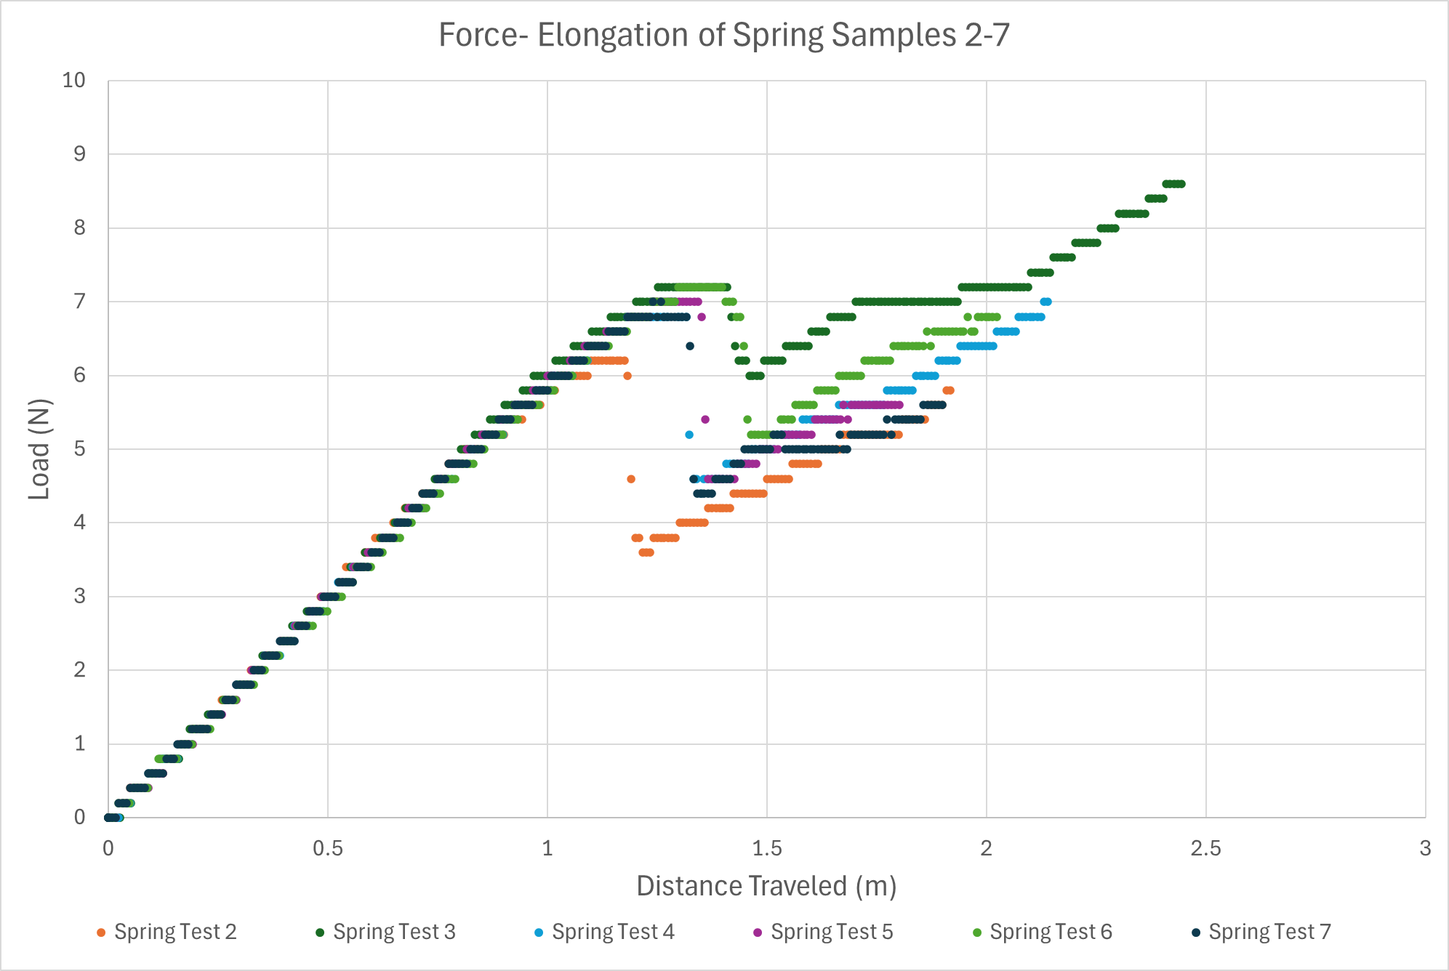
Spring Elongation Results
Spring Elongation Testing
Sample | Force (N)
1 | 7.3
2 | 6.2
3 | 7.2
4 | 7.3
5 | 7
6 | 7.2
7 | 7
Table X – Spring Elongation Failure Loads
Fig. V – Spring Elongation Test (Samples 2-7)
Shilo: 12

Slide 14
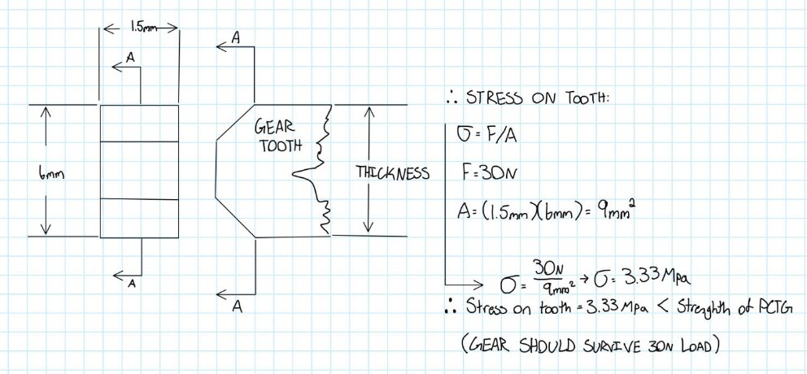
Ex.3: Gear Shear Test
XY Ultimate Tensile Stress from Horizontal Print: 33.15 MPa
Fig. VII – Gear Shear Calculations
Cassina: 13

Slide 15
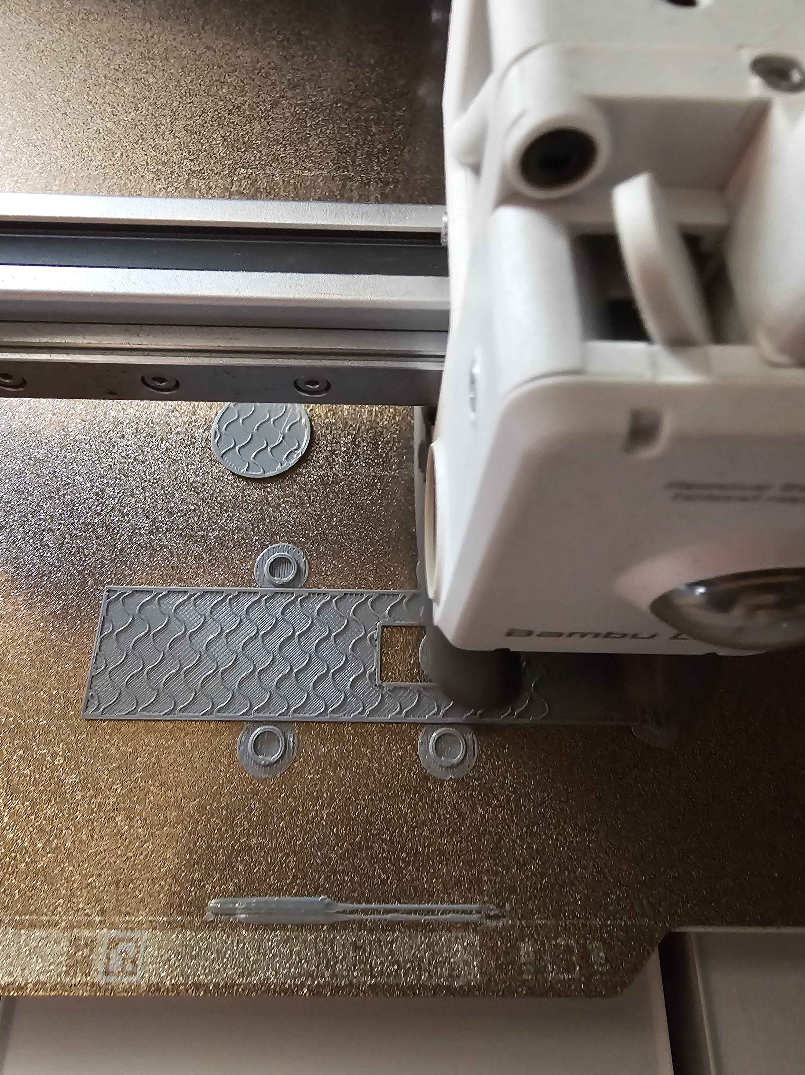
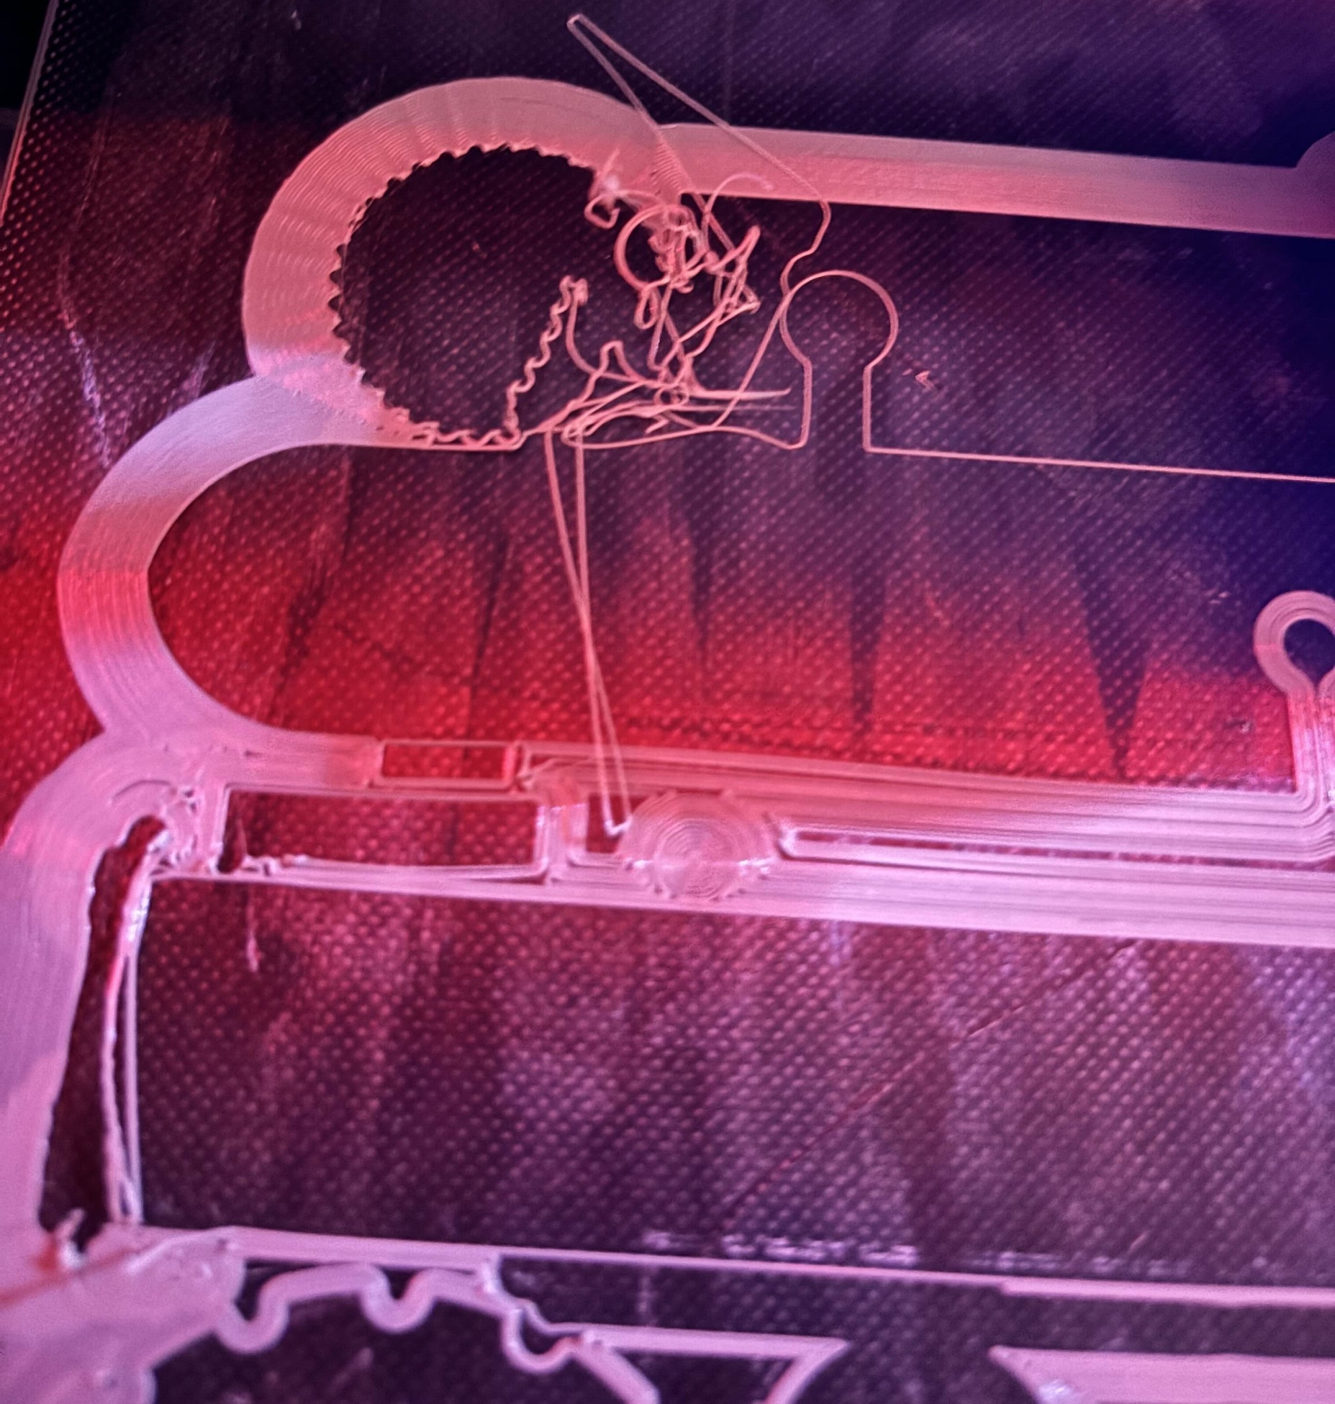
Ex.4: Printing Calibration Testing
Fig. VIII – Successful Print Layer
Fig. IX – Failed Print Layer
Carter: 14

Slide 16
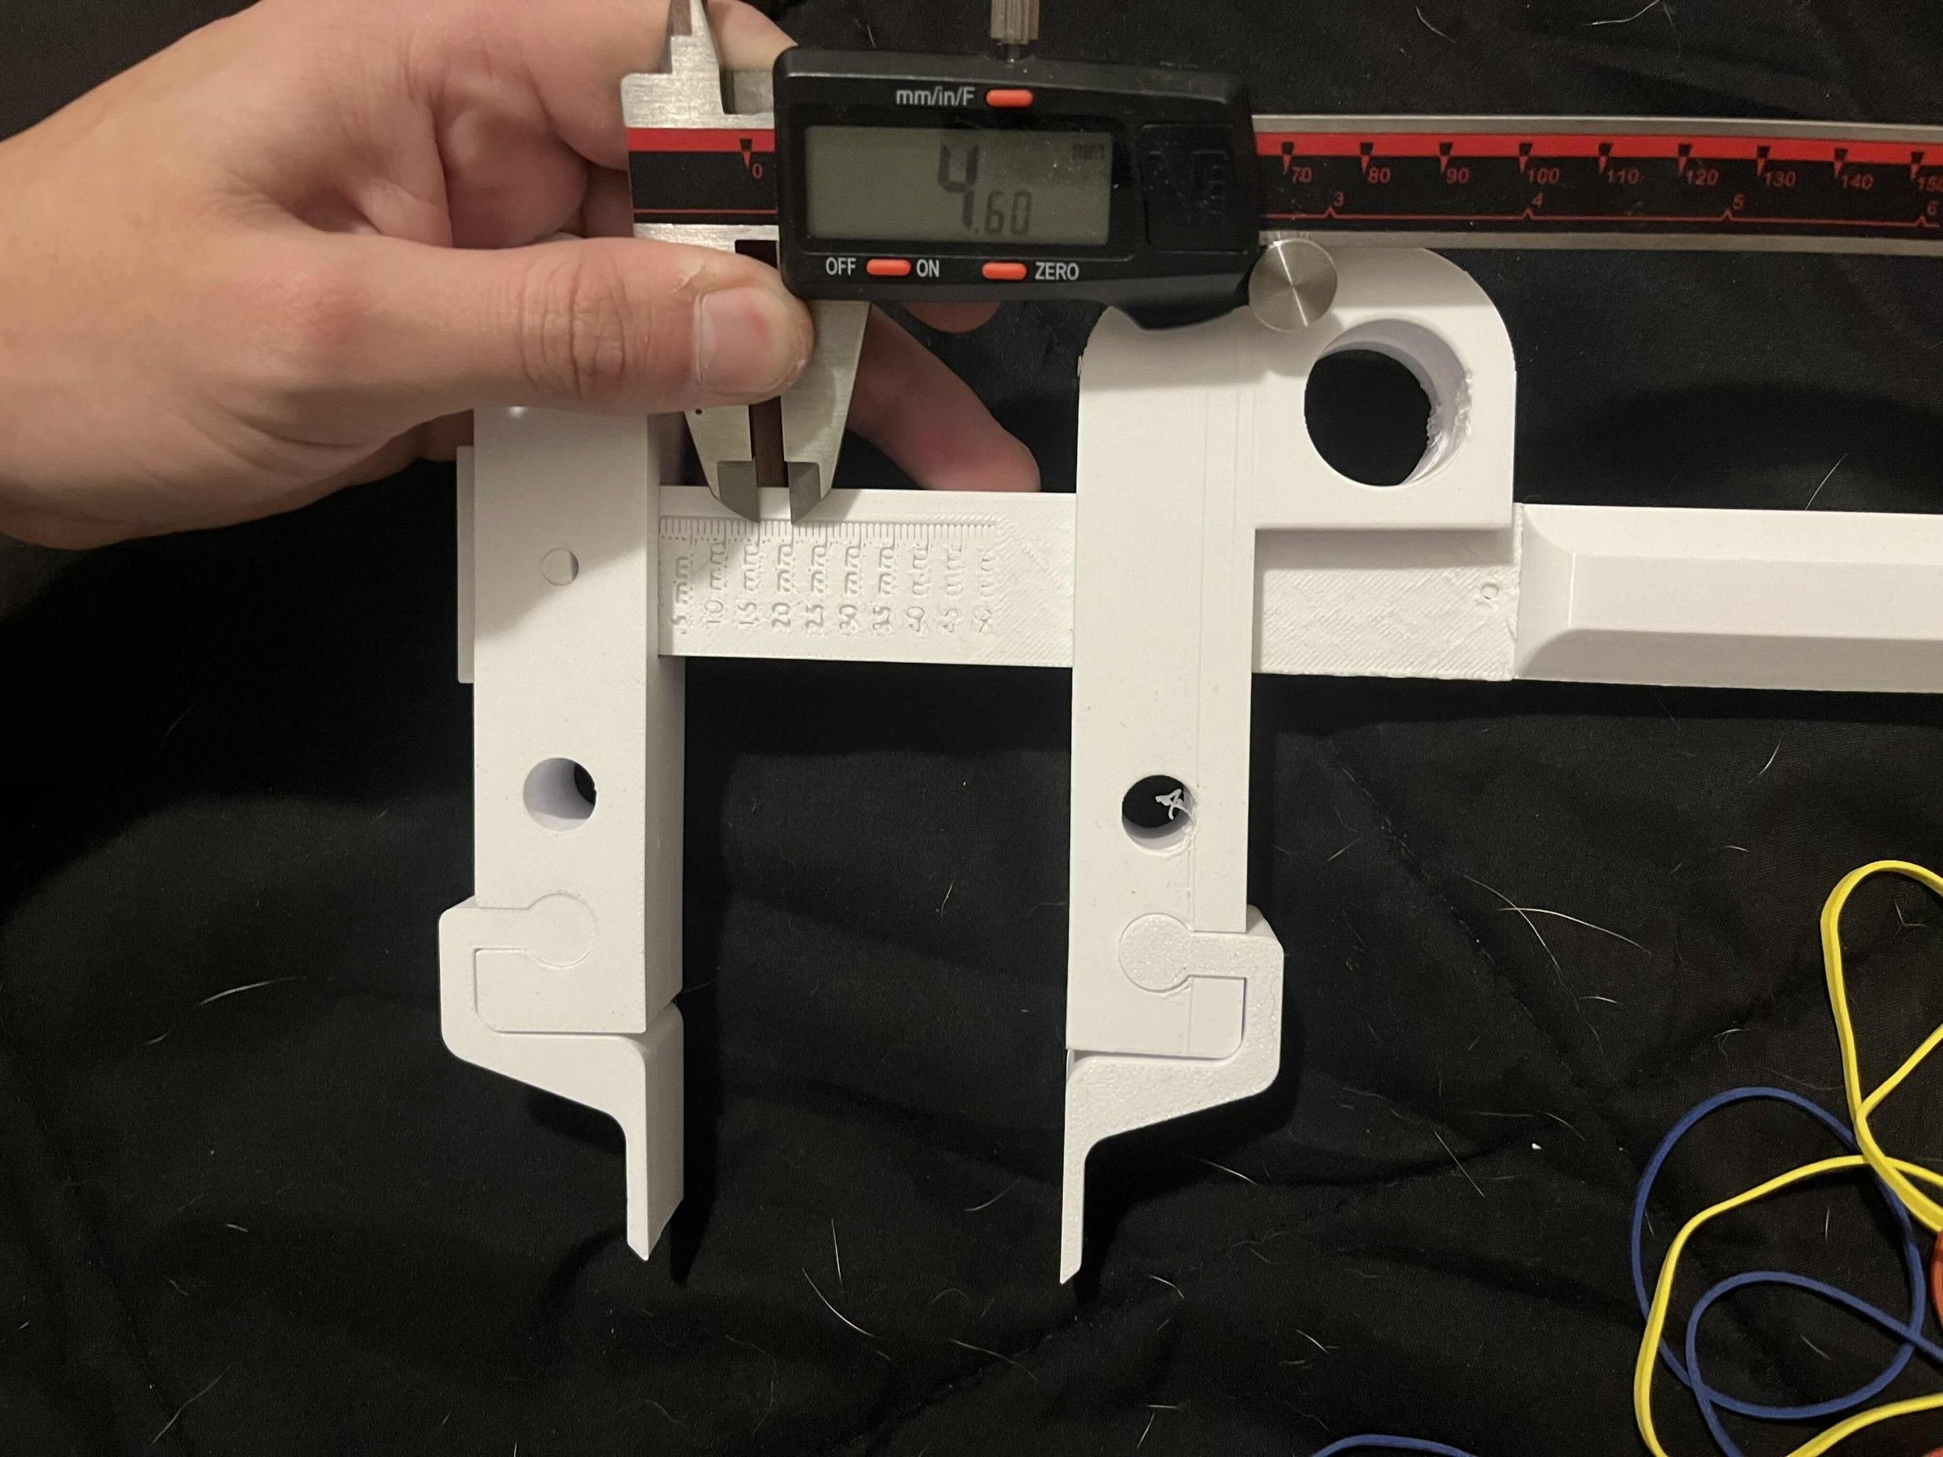
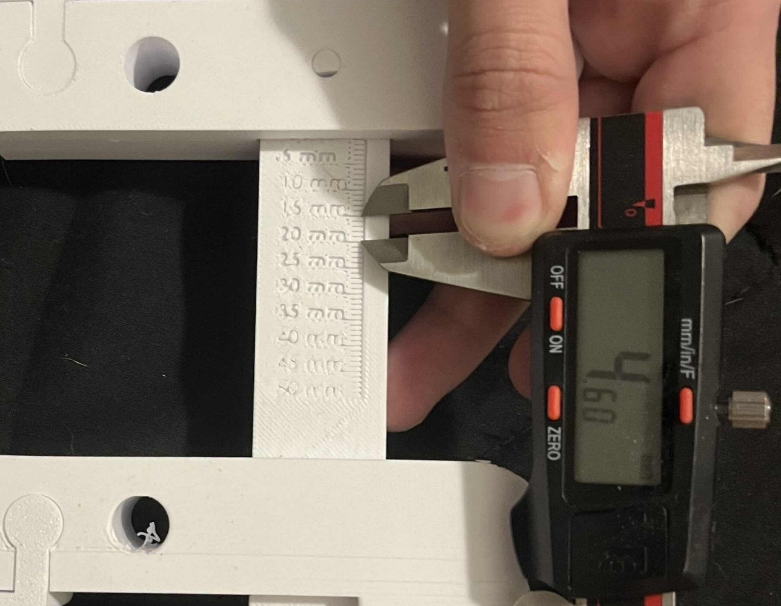
Ex.5: Measurement Testing - Ruler
Fig. X – Concomitant Measuring Results
Results:
Ruler Measurement: 5 mm
Caliper Measurement: 4.61-4.68 mm
Error: 0.32-0.39 mm or ~8.45%
Nathan: 15

Slide 17
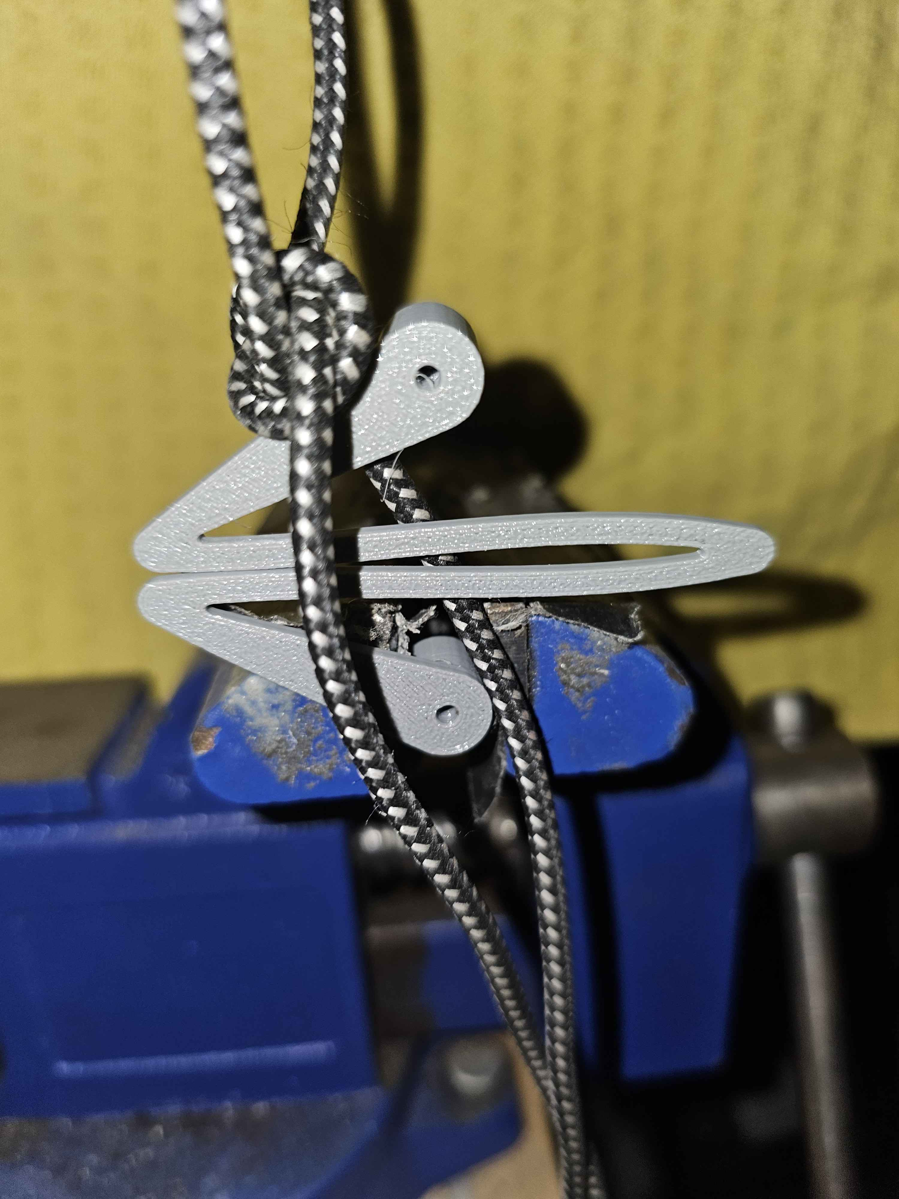
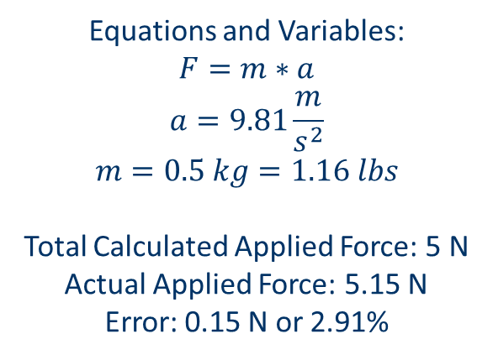
Ex.5: Measurement Testing - Spring
Equations and Variables:
$$F=m∗a$$
$$a=9.81\frac{m}{s^{2}}$$
$$m=0.5 kg=1.16 lbs$$
Total Calculated Applied Force: 5 N
Actual Applied Force: 5.15 N
Error: 0.15 N or 2.91%
Fig. XI – Spring Compression Measuring Results
Nathan: 16

Slide 18
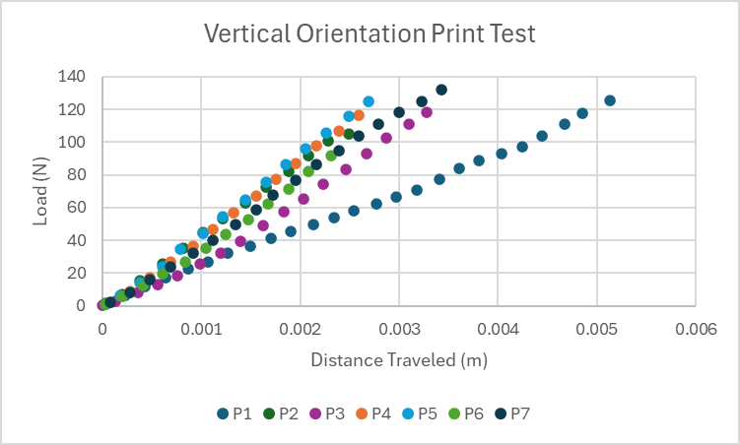
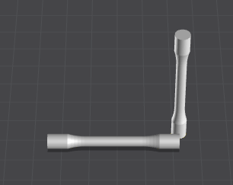
Additional Test: Material Tensile Test
Fig. XII – Creality Print Orientation Setup
Fig. XI – Vertical Material Test Results
Shilo: 17

Slide 19
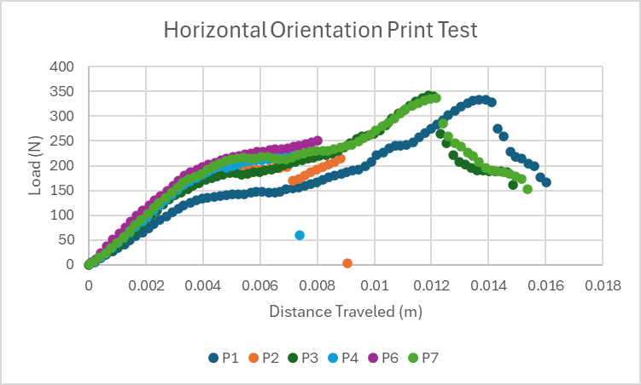
Additional Test: Material Tensile Test
Fig. XII – Creality Print Orientation Setup
Fig. XIII – Horizontal Material Test Results
Shilo: 18

Slide 20
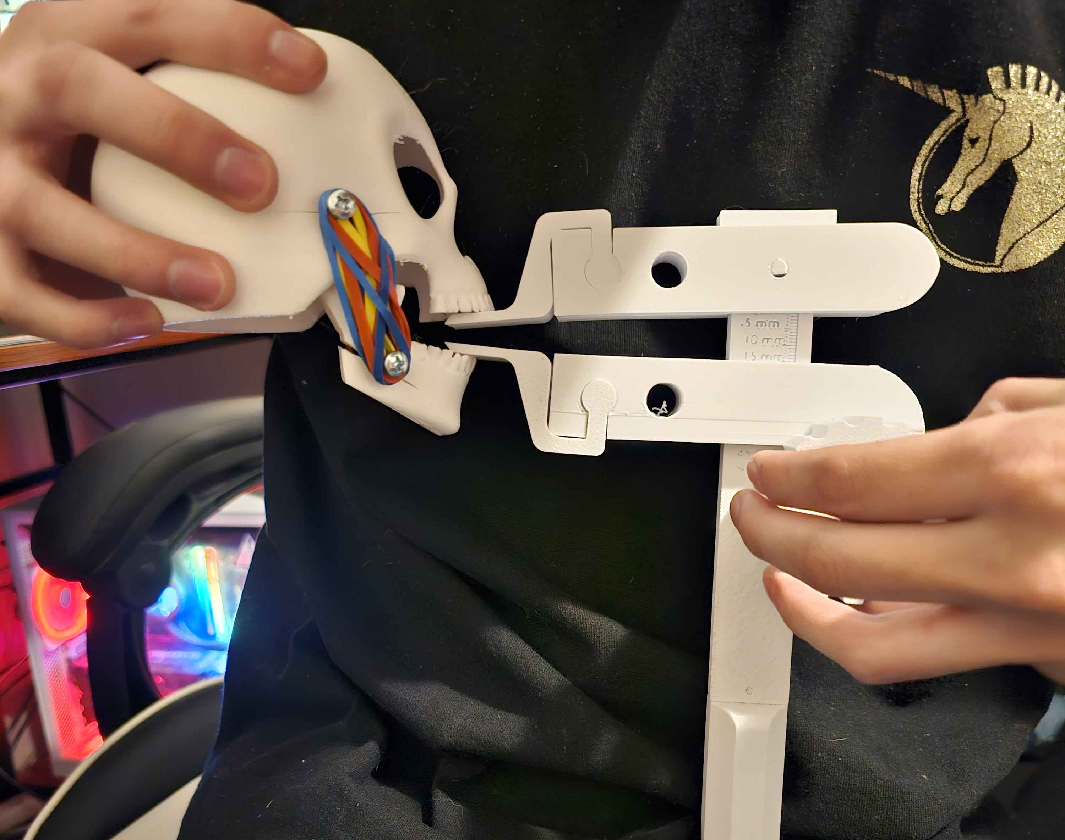
Additional Test: Model Skull
Assumptions:
Force Applied By Each Set of Bands: 8 N
# of Sets Needed to Simulate Patient: ~7.5 Sets
Maximum Sets Used: 7 Sets
Maximum Force Applied: 58 N
Fig. XIV – Model Skull Test / Demonstration
Cassina: 19

Slide 21
Thank you!
Questions?

Slide 22
References:
[1] Nina Pauli, Ulrika Svensson, Therese Karlsson & Caterina Finizia (2016) “Exercise intervention for the treatment of trismus in head and neck cancer – a prospective two-year follow-up study,” Acta Oncologica, 55:6, 686-692, DOI: 10.3109/0284186X.2015.1133928
[2] Charters E, Dunn M, Cheng K, Aung V, Mukherjee P, Froggatt C, Dusseldorp JR, Clark JR, “Trismus therapy devices: A systematic review,” Oral Oncology, Volume 126, 2022, 105728, ISSN 1368-8375, https://doi.org/10.1016/j.oraloncology.2022.105728. Accessed February 3, 2024
[3] Daniel Buchbinder, Robert B. Currivan, Andrew J. Kaplan, Mark L. Urken, “Mobilization regimens for the prevention of jaw hypomobility in the radiated patient: A comparison of three techniques,” Journal of Oral and Maxillofacial Surgery, Volume 51, Issue 8, 1993, Pages 863-867, ISSN 0278-2391, https://doi.org/10.1016/S0278-2391(10)80104-1.
[4] Emma Charters, Jamie Loy, Raymond Wu, Kai Cheng, Masako Dunn, Sarah Davies, Jonathan Clark, “Feasibility study of intensive intervention using novel trismus device during adjuvant radiation for head and neck cancer: RestorabiteTM,” Oral Oncology, Volume 146, 2023, 106558, ISSN 1368-8375, https://doi.org/10.1016/j.oraloncology.2023.106558. ‌
[5] W. R. Wagner and B. D. Ratner, Biomaterials Science: An Introduction to Materials in Medicine. San Diego, CA: Academic Press, 2020.
[6] J. B. Park and R. S. Lakes, Biomaterials: An Introduction. New York, NY: Springer, 2010.
[7] D. Dharavath and R. Maddi, “ISO standards of Medical Devices,” World Journal of Current Medical and Pharmaceutical Research, https://wjcmpr.com/index.php/journal/article/view/213 (accessed Feb. 4, 2024).
[8] M. Jeong et al., “Materials and applications of 3D printing technology in Dentistry: An overview,” MDPI, https://www.mdpi.com/2304-6767/12/1/1 (accessed Feb. 4, 2024).
[9] M. Guvendiren, J. Molde, R. Soares, and J. Kohn, “Designing biomaterials for 3D printing - ACS Publications,” ACS Publications, https://pubs.acs.org/doi/abs/10.1021/ACSBIOMATERIALS.6B00121 (accessed Feb. 5, 2024).
[10] “Biocompatible 3D resins for medical devices,” 3Dresyns, https://www.3dresyns.com/pages/bio-compatible-3dresyns (accessed Feb. 4, 2024).
[11] “Siraya Tech Blu-tough resin,” Siraya Tech, https://siraya.tech/products/blu-tough-resin-by-siraya (accessed Feb. 4, 2024).
[12] J. P. Davim, The design and manufacture of medical devices. Ch 1. Cambridge: Woodhead Publishing Ltd, 2012.
[13] D. van Gijn, et al. 'Ch.2: The mandible', Oxford Handbook of Head and Neck Anatomy, Oxford Medical Handbook e-pub, Jan. 2022.
[14] Y. Ihara et al., “The Device of Ethylene Vinyl Acetate Sheet for Trismus Caused by Bilateral Mandible Fractures,” Case Reports in Dentistry, vol. 2021, pp. 1–6, Aug. 2021, doi: https://doi.org/10.1155/2021/8340485.
[15] Center for Devices and Radiological Health, “Classify Your Medical Device,” U.S. Food and Drug Administration, Jul. 02, 2020. https://www.fda.gov/medical-devices/overview-device-regulation/classify-your-medical-device
‌[16] P. U. Dijkstra, W. W. I. Kalk, and J. L. N. Roodenburg, “Trismus in head and neck oncology: a systematic review,” Oral Oncology, vol. 40, no. 9, pp. 879–889, Oct. 2004, doi: https://doi.org/10.1016/j.oraloncology.2004.04.003.
  This paper shows the effects of radiation on certain muscle groups and joints in the mandibular area.
[17] M. Louise Kent et al., “Radiation-Induced trismus in head and neck cancer patients,” Supportive Care in Cancer, vol. 16, no. 3, pp. 305–309, Oct. 2007, doi: https://doi.org/10.1007/s00520-007-0345-5.
[18] C.-J. Wang, E.-Y. Huang, H.-C. Hsu, H.-C. Chen, F.-M. Fang, and C.-Y. Hsiung, “The Degree and Time-Course Assessment of Radiation-Induced Trismus Occurring After Radiotherapy for Nasopharyngeal Cancer,” The Laryngoscope, vol. 115, no. 8, pp. 1458–1460, Aug. 2005, doi: https://doi.org/10.1097/01.mlg.0000171019.80351.46.
[19] O. Isman, “Evaluation of jaw bone density and morphology in bruxers using panoramic radiography,” Journal of Dental Sciences, Oct. 2020, doi: https://doi.org/10.1016/j.jds.2020.09.008.
[20] J. Lee and A. Huang, “Fatigue Analysis of FDM Materials,” Rapid Prototyping Journal, vol. 19, no. 4, pp. 291–299, Jun. 2013. doi:10.1108/13552541311323290
[21] C. Guttridge, A. Shannon, A. O’Sullivan, K. J. O’Sullivan, and L. W. O’Sullivan, “Biocompatible 3D printing resins for medical applications: A review of marketed intended use, biocompatibility certification, and post-processing guidance,” Annals of 3D Printed Medicine, vol. 5, p. 100044, Mar. 2022. doi:10.1016/j.stlm.2021.100044
[22] L. Novakova-Marcincinova, J. Novak-Marcincin, J. Barna, and J. Torok, “Special materials used in FDM Rapid Prototyping Technology Application,” 2012 IEEE 16th International Conference on Intelligent Engineering Systems (INES), Jun. 2012. doi:10.1109/ines.2012.6249805

